Slide 1

MISSILE COMMAND Batch No : 03
SHRI VISHNU ENGINEERING COLLEGE FOR WOMEN
(AUTONOMOUS) Bhimavaram
COMPUTER SCIENCE AND ENGINEERING
II YEAR – II SEMESTER
Presented by
N. Lasya – 19B01A05B9
N. Tulasi – 19B01A05C2
K. Lovely Srenika – 19B01A0583
K. Durga Sreshta – 19B01A05A6
N. Vanaja – 20B05A0511
Guided By: - Mr. A. Seenu M.Tech (PhD)

Slide 2
Problem Statement
Missile Command game is an online game that can be played by a single player.
In the game there are many meteors falling from sky which may hit the city, so that, city may get destroyed.
Initially, the game screen contains a city, and it has 3 missile launchers these missile launchers are capable of launching 10 missiles. If the 10 missiles are used by the player, then missile launcher becomes inactive.

Slide 3
Problem Statement Cotd…
When the player presses on the game screen, a cross hair is displayed then missile is launched from nearest possible missile launcher to the place where mouse is pressed. When missile hits the meteor, explosion occurs.
Missile launchers are invulnerable from destruction. If the missile launcher has more than 4 missiles in it, then it is shown in bold, else it is shown with only outline of it.
Here, the main aim of the player is shoot missiles using mouse control provided and save the city from destruction.

Slide 4
Objectives
The main objective of the project is to develop Missile Command game.
The game might improve control over the actions of the players.
The game improves concentration levels of the player.
It improves the speed of reactivity to the actions of the player.

Slide 5
Modules
Modules of the project are divided based on different parts of the project (game) to be created and their functionalities.
Different modules of the project are :-
Screen Objects
City
Missile Launcher
Missile
Explosion

Slide 6
Screen Objects
Screen Objects is a module which creates all the instances that appear on the gaming screen.
The instances include missile launchers, missiles, city, explosion.
All the instances remain on screen until they are exploded. (e.g., city explodes by meteor collision until then city remains in screen).

Slide 7
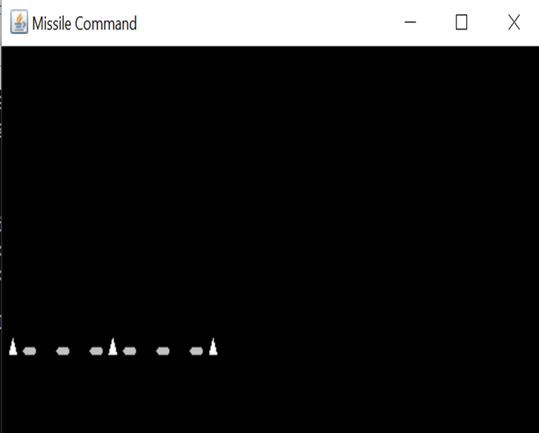
City
City is the land it contains some missile launchers.
Cities are vulnerable to explosions.
Missile Launcher
Missile Launcher launches the missile.
They are placed on the city.
They have 10 missiles in them.
Missile launcher become inactive when number of
missiles in it = 0 .
Picture displays 3 missile launchers (in cone shaped) and city (in oval shaped)

Slide 8
Missile
Missiles are Screen Objects move about on the screen.
Missiles are launched from missile launcher to hit the meteor.
They are timed to reach the target then meteor disappears.
These missiles are shot up only when player presses on any of position in gaming screen.
There are only limited number of missiles in each missile launcher

Slide 9
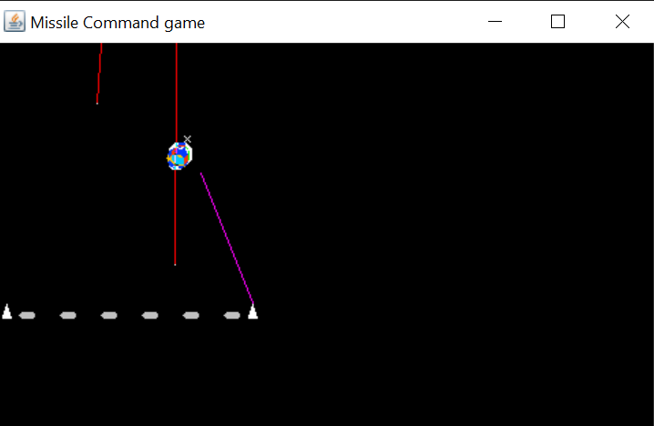
Explosion
Explosions are produced when missile hits the
meteor or when meteor hits the missile launcher.
Explosions are Screen Objects that expand and
shrink i.e., to make it visualize like smoke after
explosion.
Red colored are meteors, Pink colored are missiles and
Explosion is produced when they got hit.

Slide 10
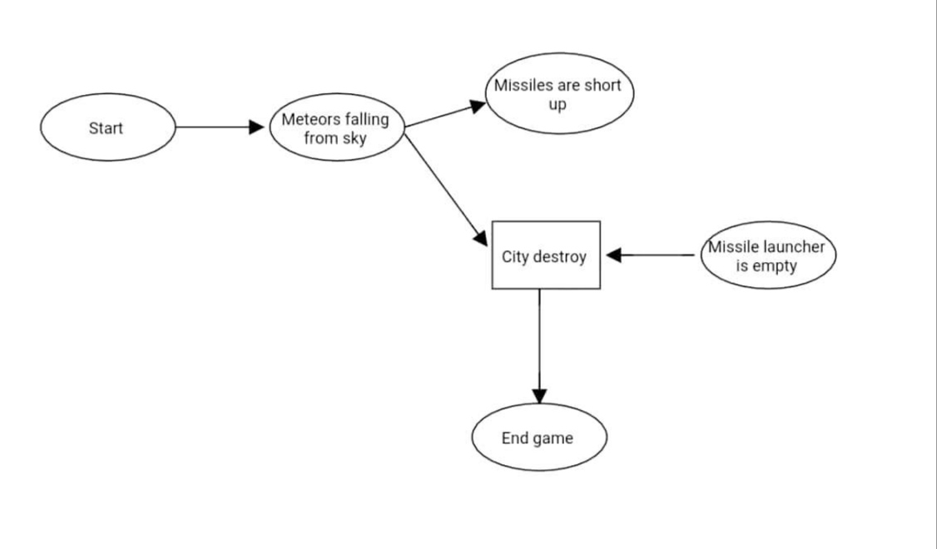
System Design

Slide 11
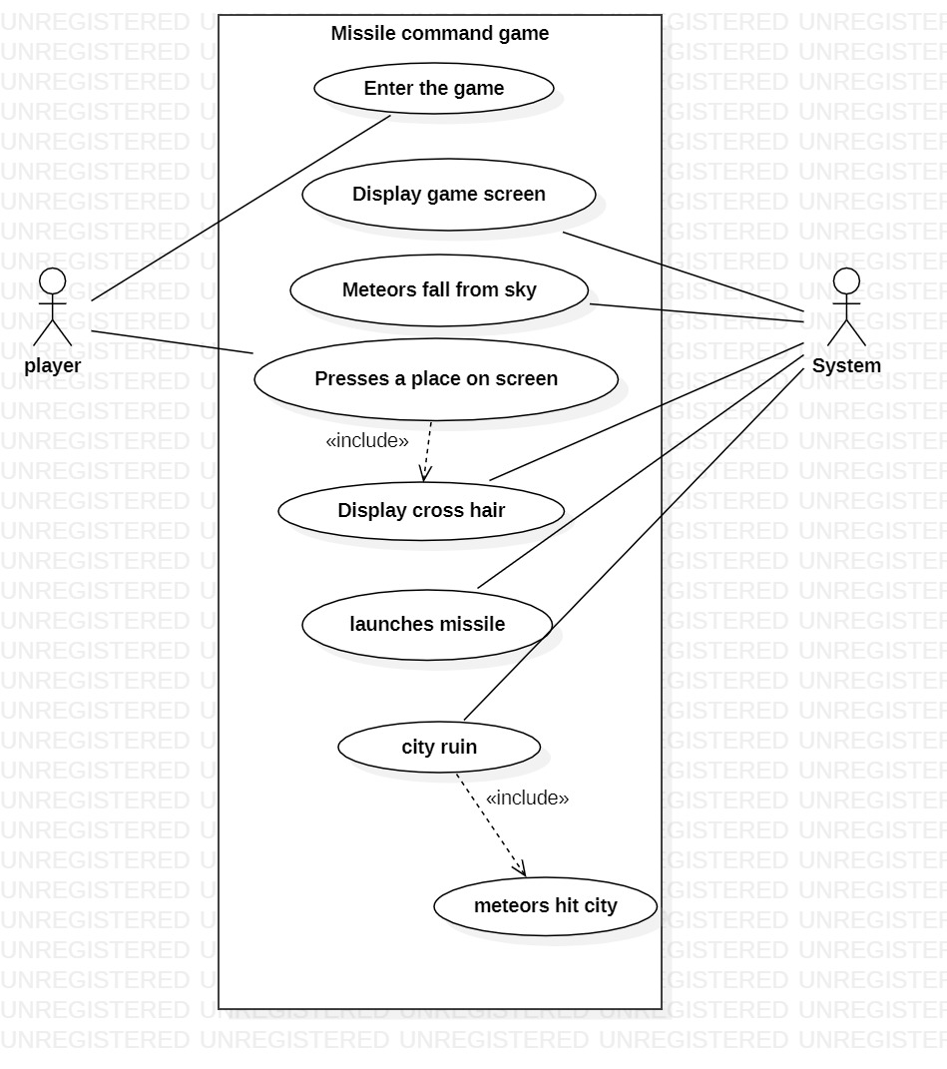
UML Diagrams
Use case diagram

Slide 12
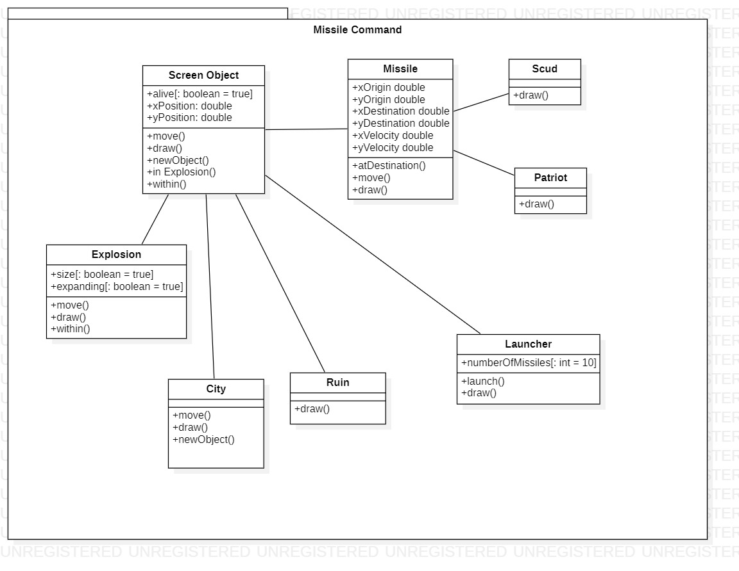
Class diagram

Slide 13
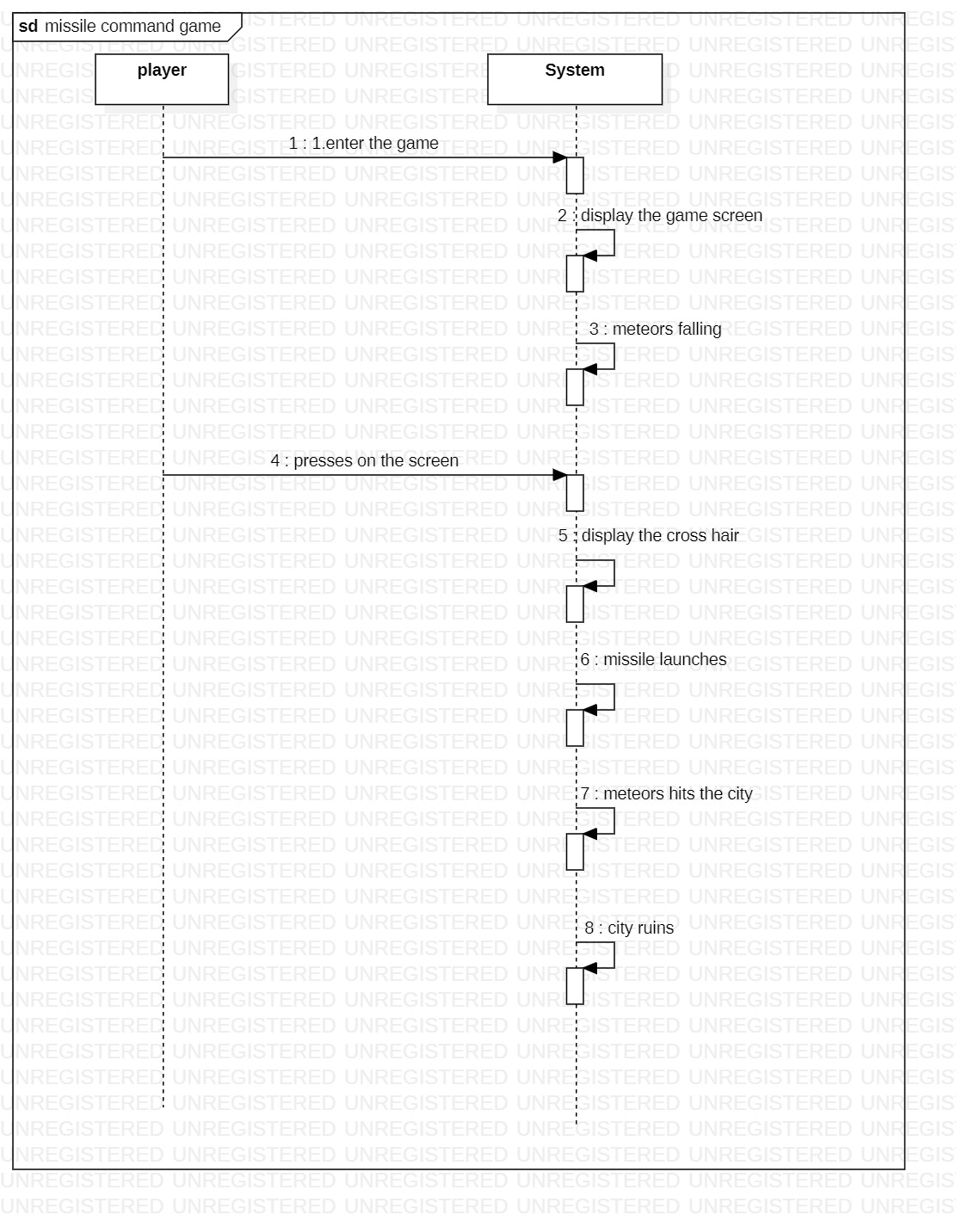
Sequence Diagram

Slide 14
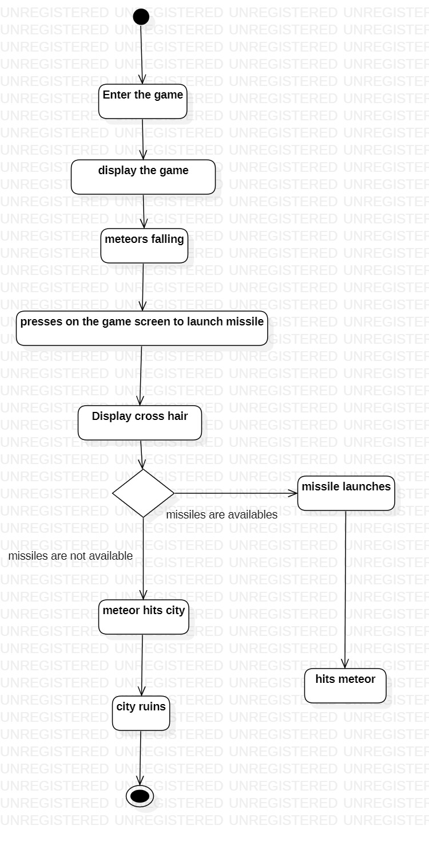
Activity Diagram

Slide 15
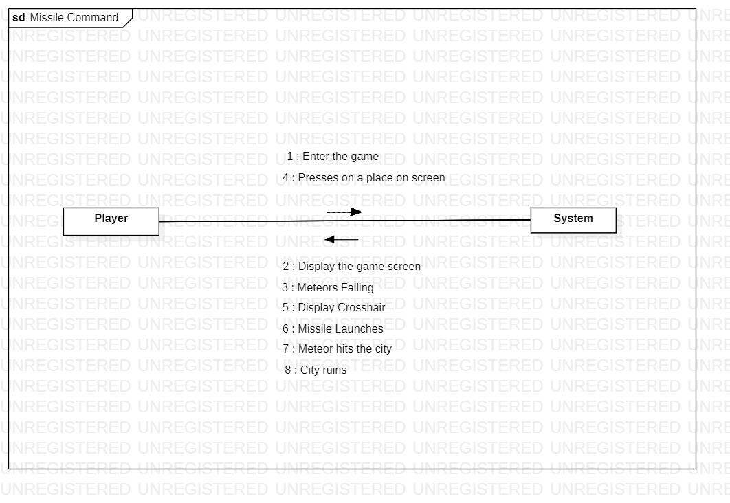
Collaboration Diagram

Slide 16
Implementation
Initial Screen
The initial screen is made using packages
java.awt package and
java.applet package
Inbuilt methods from these packages used are
public abstract void drawPolygon(int[] x, int[] y, int npoints)
public abstract void fillPolygon(int[] xPoints, int[] yPoints, int
npoints)
abstract void fillOval(int x, int y, int width, int height)
abstract void fillOval(int x, int y, int width, int height)
abstract void setColor(Color c)

Slide 17
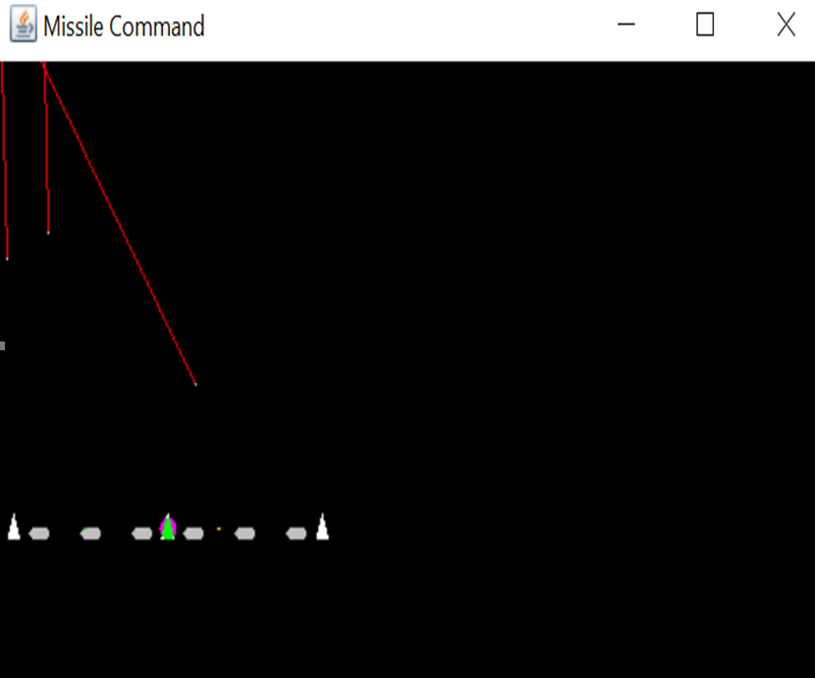
Falling of meteors
Multithreading is to implement this.
public void run() {
Thread me = Thread.currentThread();
while (thread == me) {
enemyLaunch(); // launch enemy meteor at random
repaint();
try {Thread.sleep(rest);}
catch (InterruptedException e) {} // time delay
}
}
void enemyLaunch() {
if (Math.random() > 1 - missileFrequency)
screenObjects.addElement(new Scud());
}

Slide 18
Missile Launching :
Missile is launched from nearest missile launcher among 3 to the point where mouse is pressed.
int smallestDistance = 1000;
int nearestLauncher = 1;
for (int n = 0; n < 3; n++) {
int distance = (int)Math.sqrt((mouseX - ((Launcher)screenObjects.
elementAt(n)).xPosition)*(mouseX - ((Launcher)screenObjects.elementAt(n)).
xPosition) + (mouseY - ((Launcher)screenObjects.elementAt(n)).yPosition)*
(mouseY - ((Launcher)screenObjects.elementAt(n)).yPosition));
if (distance < smallestDistance && ((Launcher)screenObjects.
elementAt(n)).numberOfMissiles > 0) {
smallestDistance = distance;
nearestLauncher = n;
}
}

Slide 19
Explosion
Explosion first expands until it’s limits then it shrinks.
void move(Vector screenObjects) {
if (expanding) { //expanding of explosion
if (size < 10)
size += 0.1;
else
expanding = false;
}
else { //shrinking of explosion
if (size > 0)
size -= 0.1;
else
alive = false;
}
}

Slide 20


